Slide 1

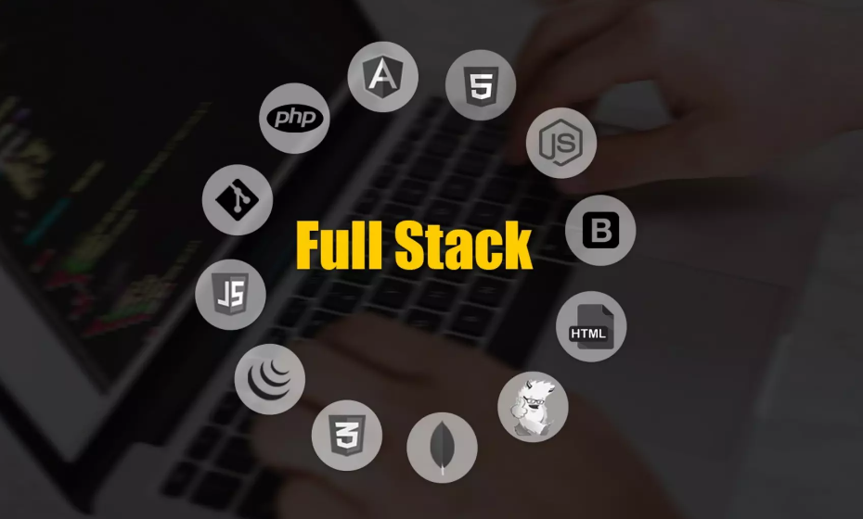
LAKHMI CHAND INSTITUTE OF TECHONOLOGY DEPARMENT OF COMPUTER SCIENCE ENGINEERING
Full Stack Web Development
PRESENTED BY:
Nikita Kumar

Slide 2
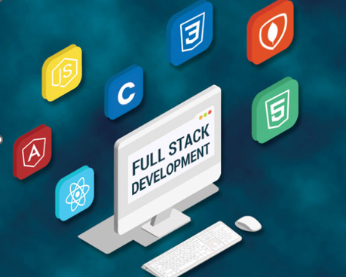
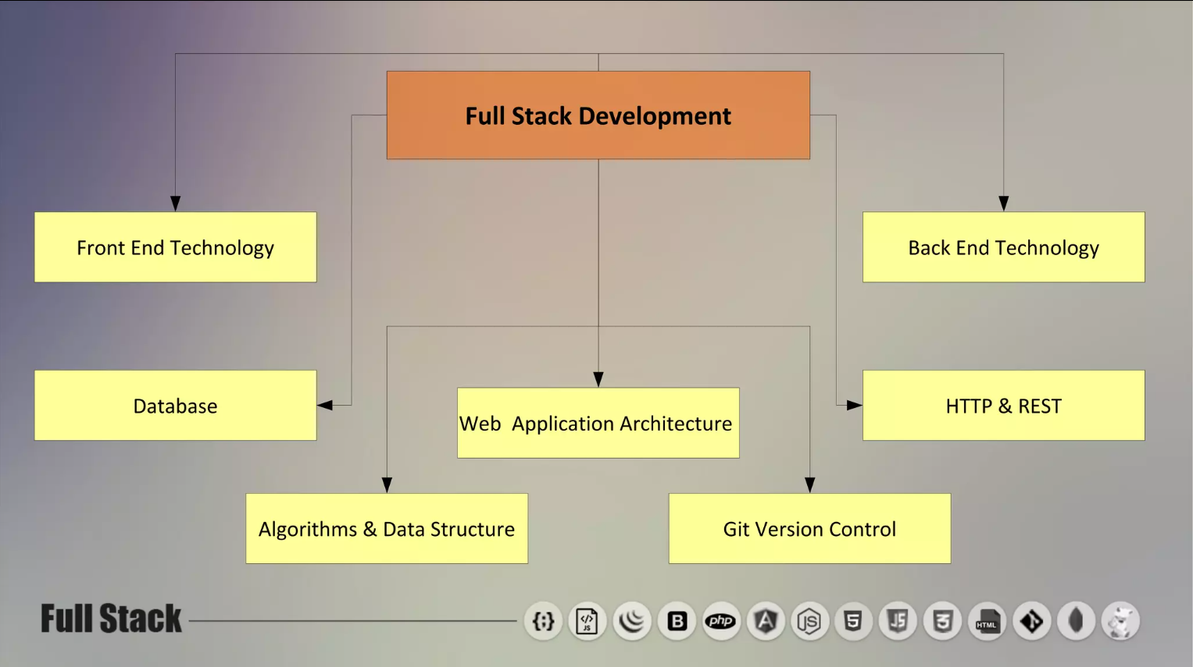
CONTENTS
Introduction
Layers In Full Stack Development
Front End Technology
Back End Technology
Databases
Git Version Control

Slide 3
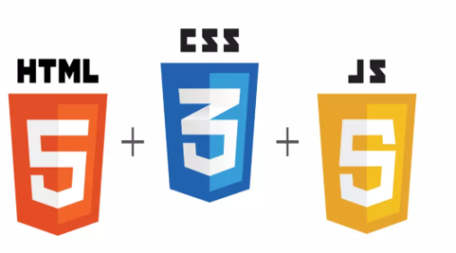
WHAT IS FULL STACK DEVELOPEMENT ?
Full stack development:
It refers to the development of both front-end (client side) & back-end (server side)
Portions of web applications.
Front-end Technologies in Full Stack Includes:
1.HTML
2.CSS
3.JavaScript
4.Bootstrap

Slide 4
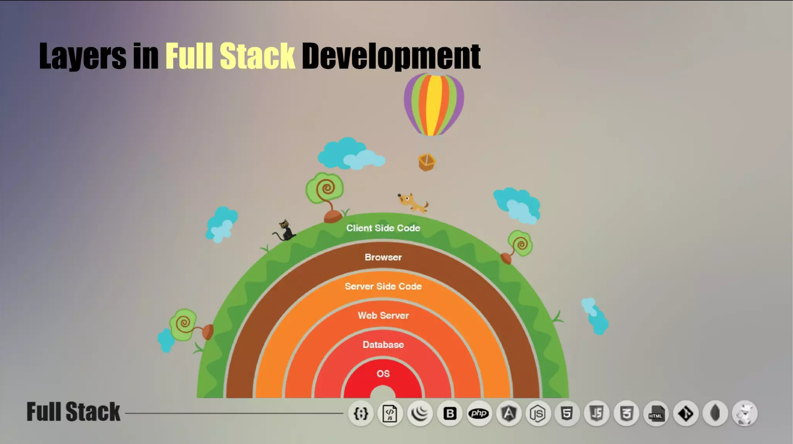
LAYERS IN FULL STACK DEVELOPMENT

Slide 5
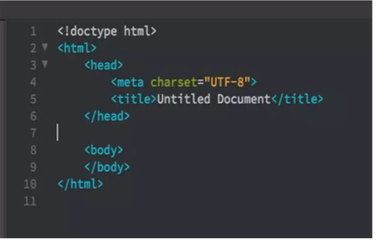
HYPERTEXT MARKUP LANGUAGE
HTML is the standard markup language for creating web pages and wed applications. Web browsers receive HTML documents from a web server or local storage and render the documents into multimedia web pages. HTML documents into multimedia of a web pages. HTML describes the structure of a web pages semantically & originally included cues for the appearance of the document.

Slide 6
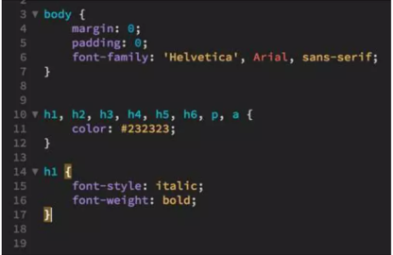
CASCADING STYLE SHEETS
CSS is a style sheet language used for describing the presentation of a documents written in markup language like HTML.
CSS is designed to enable the separation of presentation and content , include layout, colors and fonts.

Slide 7
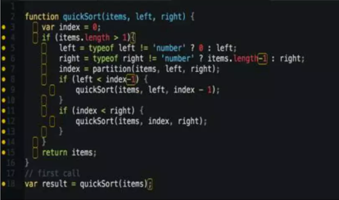
JAVASCRIPT
A high –level interpreted programming language. It is a dynamic language. JavaScript enables interactive web pages and is an essential part of web applications. The vast majority of websites uses it and major web browsers have a dedicated JS engine to execute it.

Slide 8
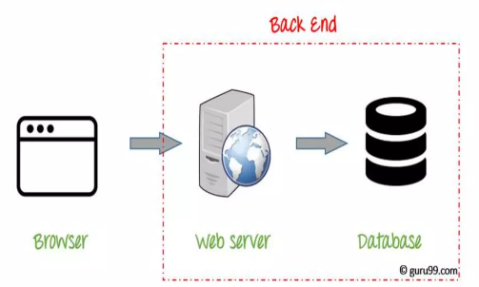
BACK-END DEVELOPMENT
Back-end development refers to the server side of an applications & everything that communicates between the database and the browser.
Back-end Technologies in Full Stack Includes:
1.Java(Spring)
2.Python(Django, Flask)
3.PHP (Laravel)
4.Nodejs
Database Technologies in Full Stacks Includes:
MySQL, MongoDB

Slide 9
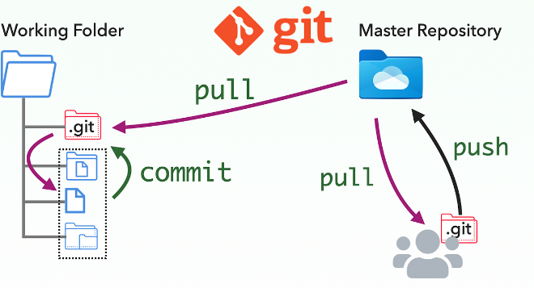
GIT VERSION CONTROL
Version control is a system that records changes to a file or set of files over time so that you can recall specific versions later.
Git is a distributed version control system that enables software development teams to have multiple local copies of the project's codebase independent of each other.

Slide 10


